Slide 1


Training Techniques
BY
SURESH GUTUR
28-07-2022
THURSDAY

Slide 2

WHAT IS TRAINING TECHNIQUE?
It is a particular method of doing an activity in training, usually a method that involves practical skills.
WHY TRAINING TECHNIQUE IS REQUIRED?
Delivering effective and engaging presentations to a variety of audiences

Slide 3
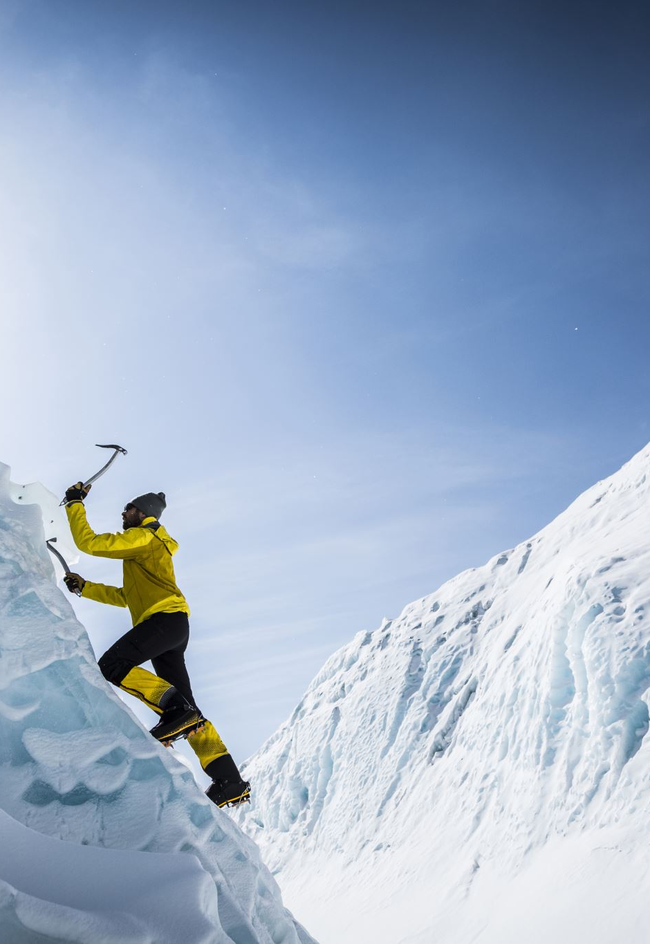
ICEBREAKING
The technique is often used when people who do not usually work together, or may not know each other at all, meet for a specific, common purpose
Story telling
Polls
True/false
Known/surprising facts
Two Truths and a Lie

Slide 4

Buzzgroup
A small, intense discussion group usually involving up to 3 persons responding to a specific question or in search of very precise information

Slide 5

Lecture
An oral presentation intended to present information or teach people about a particular subject

Slide 6

Roleplay
To explore realistic situations by interacting with other people in a managed way

Slide 7

Casestudy
The exploration of a real issue within a defined context, using a variety of data sources
An in-depth study of one person, group, or event
A research approach that is used to generate an in-depth, multi-faceted understanding of a complex issue
This Photo by Unknown Author is licensed under CC BY

Slide 8

Discussion Method
A training method in which both trainer and participants actively contribute to the instructional process

Slide 9

THANK YOU!
SURESH GUTUR
Phone:
9493204094
Facebook:
facebook.com/suresh.gutur
Email:
suresh.gutur9@gmail.com

